Slide 1



Git Overview

Slide 2
Git
Git is a tool for tracking changes made to a set of files over time,
which is known as “version control.”
Git helps to
Examine the state of your project at earlier points in time
Show the differences among various states of the project
Split the project development into multiple independent lines, called “branches,” which can evolve separately
Periodically recombine branches in a process called “merging,” reconciling the changes made in two or more branches
Allow many people to work on a project simultaneously, sharing and combining their work as needed
…and much more
MVP Phase

Slide 3
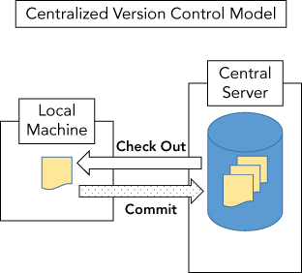
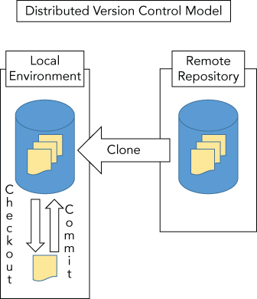
Version Control Systems
Version control systems (VCS) such as Git can be broadly classified as either centralized or distributed.
Git is an example of a distributed version control system (DVCS).
Examples of a centralized version control system (CVCS) would be Concurrent Versions System (CVS) and Subversion.
MVP Phase

Slide 4
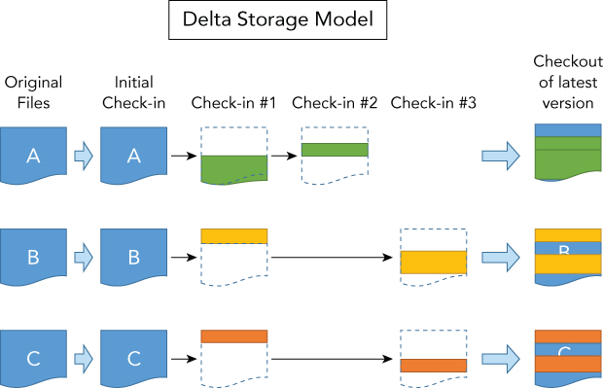
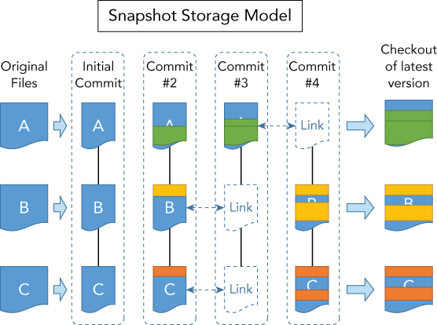
Tracking Changes
MVP Phase
In a traditional source management system, content is managed on a file-by-file basis
Each file is stored as a separate object in the repository
It then stores that delta as the file's next revision
Git uses a storage model - snapshot storage
Git tracks revisions at the level of a directory tree
Each revision within a Git repository as being a slice of a directory tree structure at a point in time—a snapshot.

Slide 5
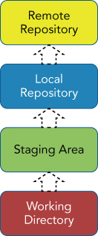
Git – Levels of Promotion of Code
The remote repository is a separate Git repository intended to collect and host content pushed to it from one or more local repositories
The combination of the working directory, staging area, and local repository make up your local environment.
MVP Phase
The Local repository is the actual source repository where content that Git manages is stored. Once content is committed to the local repository, it becomes a version in the repository and can be retrieved later
Staging area serves as a holding area to accumulate and stage changes from the working directory before they are committed into the next level
Working directory where content is created, edited, deleted, and so on. Any new content must exist here before it can be put into (tracked by) Git

Slide 6
Git – Repository Object Store
Git repository is an object store. This is a database that holds just four kinds of items: blobs, trees, commits, and tags.
Blob : A blob is an opaque chunk of data, a string of bytes with no further internal structure
Every version of a file in Git is represented as a whole, with its own blob containing the file’s complete contents
Tree : A Git tree, then, represents a portion of the repository content at one point in time: a snapshot of a particular directory’s content, including that of all directories beneath it.
It represents a single level of directory structure in the repository content.
It contains a list of items, each of which has:
A filename and associated information that Git tracks, such as its Unix permissions (“mode bits”) and file type Git can handle Unix “symbolic links” as well as regular files.
A pointer to another object. If that object is a blob, then this item represents a file; if it’s another tree, a directory.
Commit: A commit is the fundamental unit of change in Git. A commit is a snapshot of the entire repository content, together with identifying information, and the relationship of this historical repository state to other recorde d states as the content has evolved over time.
TAG A tag serves to distinguish a particular commit by giving it a human-readable name in a namespace reserved for this purpose.
MVP Phase

Slide 7
Git Commit
Repository
A Git project is represented by a “repository,” which contains the complete history of the project from its inception.
Commits
A repository in turn consists of a set of individual snapshots of project content—collections of files and directories —called “commits.”
A single commit consists of:
Tree : A structure of nested files and directories representing a complete state of the project
Author: Name, email address, and date/time (or “timestamp”) indicating who made the changes that resulted in this project state and when
Committer: The same information about the person who added this commit to the repository (which may be different from the author)
Commit Message: Text used to comment on the changes made by this commit
Reference to Parent Commits: Zero or more references to other commits in the same repository, indicating immediately preceding states of the project content
MVP Phase

Slide 8
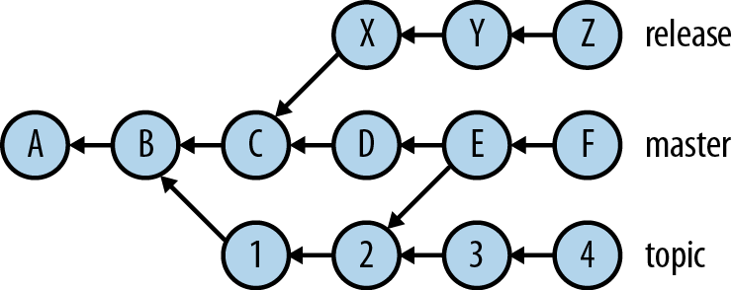
Git Branches
Git supports the concept of branches
In Git, there are branches
that exist in the local repository (local branches) and
that exist in the remote repository (remote branches).
Synching of these branches can be done using some of the commands working with remote repositories.
At any point in time, one branch is active in the local environment
MVP Phase

Slide 9
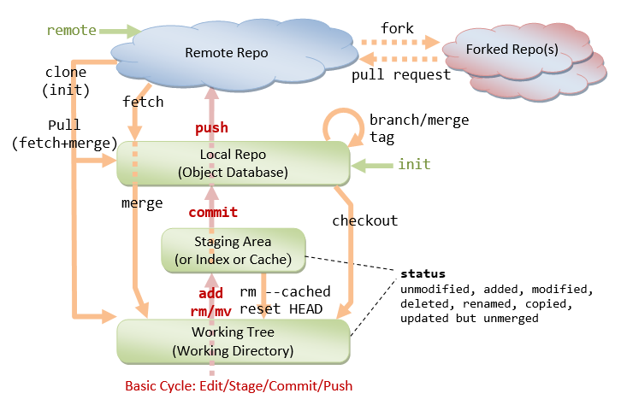
Git – Sharing work
Sharing work between repositories via operations called “push” and “pull”:
You pull changes from a remote repository and
push changes to it.
“Clone” it from an existing repository over a network via protocols such as HTTP and SSH
New repository does retain a reference to the original one, called a “remote.”
This reference includes the state of the branches in the remote as of the last time you pulled from it; these are called “remote tracking” branches
When you pull, Git updates the remote-tracking branches with the current state of the origin repository; conversely, when you push, it updates the remote with any changes you’ve made to corresponding local branches.
If these changes conflict, Git prompts you to merge the changes before accepting or sending them, so that neither side loses any history in the process.
MVP Phase

Slide 10
Git – Config
Personal Git configuration is in ~/.gitconfig;
Its format is called INI style
[user]
name = Richard E. Silverman
[color]
ui = auto # overall default for color usage
[mergetool "ediff"]
trustExitCode = true
git config --{local,global,system} parameter value
local - change the configuration for that repository only
global applies to your overall personal Git configuration in ~/.gitconfig
system option changes the system-wide configuration on the machine you’re logged into, which applies to all users , usually /etc/gitconfig
$ git config --global user.name ”Kumar Saurav"
$ git config --global user.email kumars@testgit.com
Use Text Editor:
$ git config --global core.editor emacs
Abbreviate commit IDs
$ git config --global log.abbrevCommit yes
$ git config --global core.abbrev 8
Improve readability
$ git log --pretty=oneline
Command aliases
$ git config --global alias.cp cherry-pick
Pass the alias definition to the shell in ~/.gitconfig:
[alias] setup = ! "git init; git add .; git commit"
MVP Phase

Slide 11
Git – Get Started
Help
$ git help commit
Using Unix Man Page
$ man git-commit
Creating a New, Empty Repository $ git init directory
Importing an Existing Project
$ git init
$ git add .
$ git commit -m ‘Starting my Project!’
The initial commit will be added to a new default
branch named master
$ git branch
* master
Understand the changes
$ git log --stat
$ git log --pretty=oneline
Ignoring Files
object code
*.o, *.so, *.a, *.dll, *.exe
Bytecode
*.jar (Java), *.elc (Emacs Lisp), *.pyc (Python)
toolchain artifacts
config.log, config.status, aclocal.m4
Makefile.in, config.h
Files named .gitignore in your working tree will list files as “untracked”
All .gitignore files in the current and containing directories in the repository are read, with rules in files closer to the current directory overriding those in files farther away.
MVP Phase

Slide 12
Git – Making Commits
Before committing, you add to the index those changes you want to commit. This can skip some changes you’ve made to your working files, if you’re not ready to commit those yet.
Add a New File or changes to the existing file :
$ git add filename
The filename can be a directory, in which case Git adds all new files and changes to tracked files under that directory.
Add partial changes through interactive loop
$ git add –patch (-p)
Add only changed (updated/deleted), but not new $ git add –u
Add All files
$ git add -A
Removing file from index
$ git rm filename
Renaming a file within index
$ git mv foo bar
Unstaging changes
$ git reset
Commiting a change to local repository
$ git commit -m "an interesting commit message”
Committing in Stages
Use git add to stage a subset of your changes
Run git stash --keep-index saves and undoes your outstanding, unstaged changes
Run git commit. If working tree is good
git stash pop to restore your remaining unstaged changes, and go back to step 1 and repeat the cycle
MVP Phase

Slide 13
Git – Undoing and Editing Commits
Changing the last commit:
$ git commit –amend
Discarding the last commit:
$ git reset HEAD~
Discarding the any number of commits (starting 0):
$ git reset HEAD~3
Undoing a commit:
$ git revert 9c2e84fad
This will compute the diff between that commit and the previous one, reverse it, and then attempt to apply that to your working tree
Partial Undo
# -n to not to commit changes
$ git revert -n commit
# unstage all the changes with reset
$ git reset
#restage only those you want using the interactive
$ git add -p
$ git commit $ git checkout
MVP Phase

Slide 14
Git – Rebase
Editing a series of commits
The feature to use is git rebase. Rebasing is a general technique intended to move a branch from one location to another
$ git rebase -i HEAD~n
Git starts your editor and presents a one-line description of each commit
# action commit-ID subject
pick 51090ce fix bug #1234
pick 15f4720 edit man pages for spelling and grammar pick 9b0e3dc add prototypes for the 'frobnitz' module pick 583bb4e fix null pointer (We are not strong.)
pick 45a9484 update README
Now edit the first column, the action, to tell Git what you want to do with each commit
The available actions are:
Pick Use the commit as-is. Git will not stop for this commit unless there is a conflict.
Reword Change just the commit message. Git allows you to edit the message before reapplying this commit.
Edit Change the commit contents (and message).
Here, Git stops after remaking this commit and allows you to do whatever you want.
Typically use git commit --amend to replace the commit, then git rebase --continue to continue with the rebase operation.
However, you could also insert further commits.
Squash Make this commit’s changes part of the preceding one. To meld several consecutive commits into one, leave the first one marked pick and mark the remaining ones with squash. Git concatenates all the commit messages for you to edit.
Fixup Like squash, but discard the message of this commit when composing the composite message.
In case CONFLICTS fix , and run git rebase --continue
MVP Phase

Slide 15
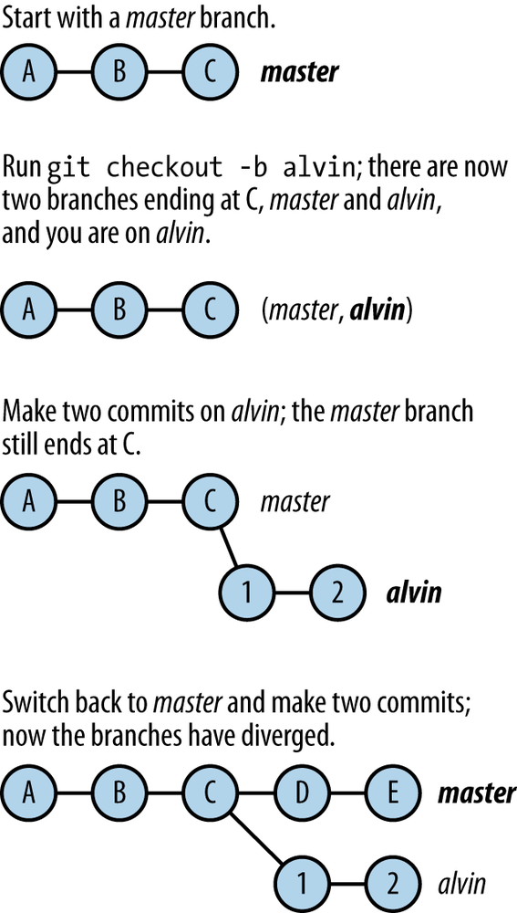
Git – Branching
Making a new Branch
$ git checkout -b alvin
Specify a commit at which to start the new branch, rather than the current one
$ git checkout -b Joel 9c6a1fad
Switching Branches
$ git checkout Joel
Uncommitted changes during swiitching Branches
If the committed versions in the current and destination branches are the same
$ git checkout manny
M file_changed
Switched to branch ‘manny’
If the committed versions differ then Git warns you and refuses to switch
error: Your local changes to the following files would be overwritten by checkout: foo Please, commit your changes or stash them before you can switch branches. Aborting
MVP Phase

Slide 16
Git – Branching
Deleting a Branch
$ git branch -b kevin
Renaming a branch
$ git branch -m old new
Remote Branches
There is no direct way to rename the corresponding branch in a remote repository, however; you must separately push the new branch and delete the old one:
$ git push -u origin new
$ git push origin :old
MVP Phase

Slide 17
Git – Tracking remote repositories
Cloning a remote repository
$ git clone https://github.com/golang-samples/websocket.git
OR
$ git clone git@github.com:golang-samples/websocket.git
Adding a reference to remote branch to existing folder
$ git remote add zeus http://olympus/zeus.git
$ git fetch --all zeus
Remote Branches
$ git branch --all
master origin/master origin/topic
Origin refers to the remote repository
Pull Changes from remote
$ git pull [origin] [branch] OR $ git pull [origin] [branch]
Push Changes to remote
$ git push [origin] [branch]
MVP Phase

Slide 18
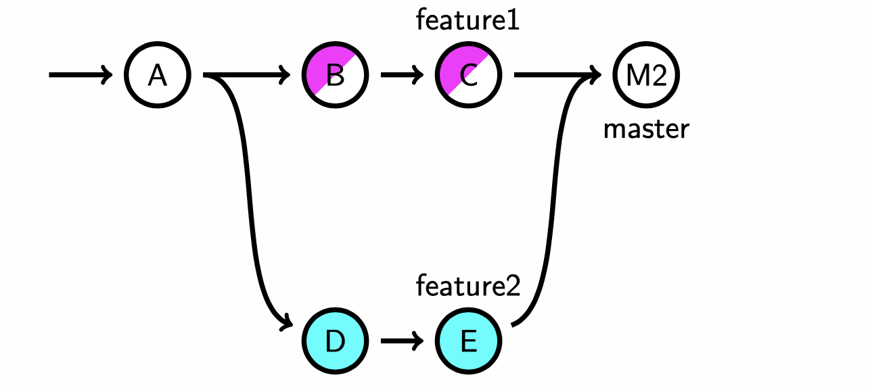
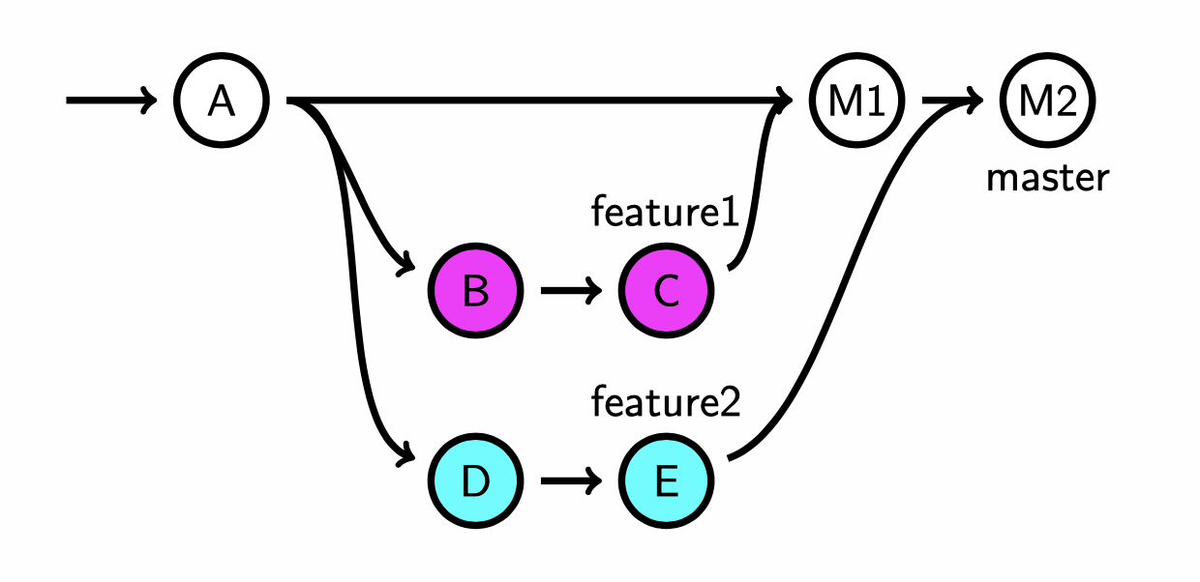
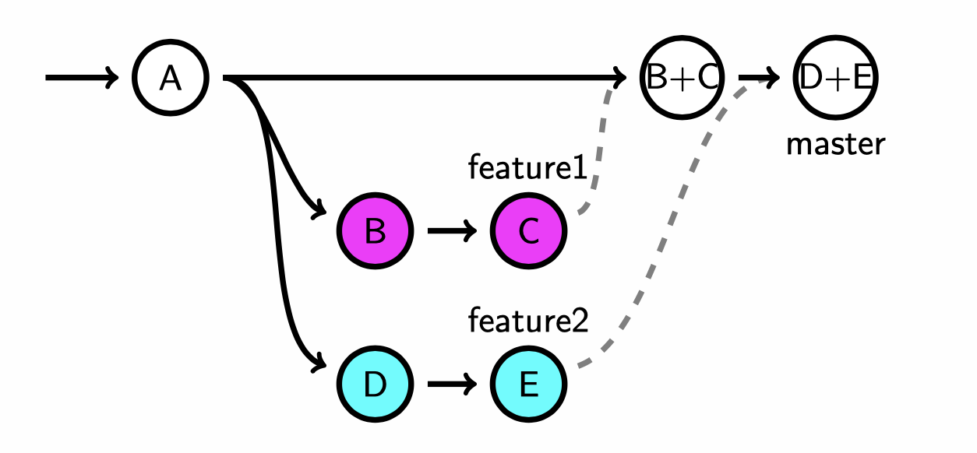
Git – Merging commits
Git Merge, default/fast-forward
$ git merge feature1
Commits without conflicts are simply absorbed into the branch as they are, and without merge commits
Conflicts are resolved through merge commit
Git Merge, no fast-forward
$ git merge feature1 - -no-ff
View history with log
$ git log --graph --pretty=format:'%s’
Squash on merge
$ git merge --squash feature1
MVP Phase

Slide 19
Git – Excercise
Create a github repository
Clone or point the local repository to the remote
Add a file to the staging/index
Commit the file to local repository
Make changes to the same file
Squash the change
Commit the first change to local repository
Restore the second change and commit
Push the changes to the remote
Create a remote branch
Make changes to the file in new branch
Commit changes from new branch
Switch to Master
Make changes to the same file
Commit the change and push to remote
Switch to feature branch
Make changes to the file
Commit the change
Merge the changes onto Master
Push the change to remote
MVP Phase

Slide 20

THANK
YOU
INFINITE COMPUTER SOLUTIONS

